Slide 1


PORTFOLIO.
ASSOCIATE PROFESIONAL | PRODUCTION EXCELLENCE | BUSINESS ANALYST
By Adi Setiadi
iamsetiadi88@gmail.com https://www.linkedin.com/in/adi-setiadi/

Slide 2

Table of
Content
About me Vision / mission
Personal skills Work experience
Portfolio Contact
Summary
I am an experienced business analyst specializing in corporate strategy and financial performance management. I have over 7.9 years of experience at Cargill, a global agribusiness and food production company. I specialize in driving growth through the development and delivery of meaningful strategic plans, market analysis, and financial management
02/

Slide 3
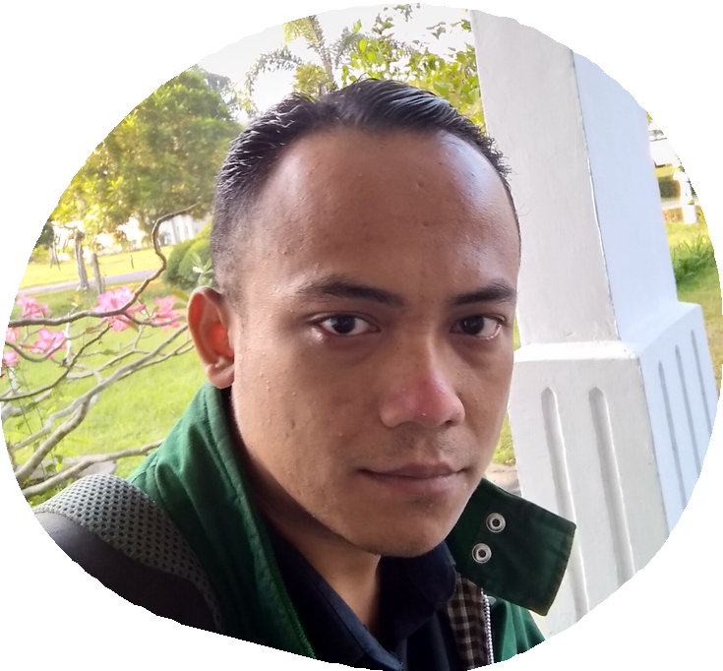
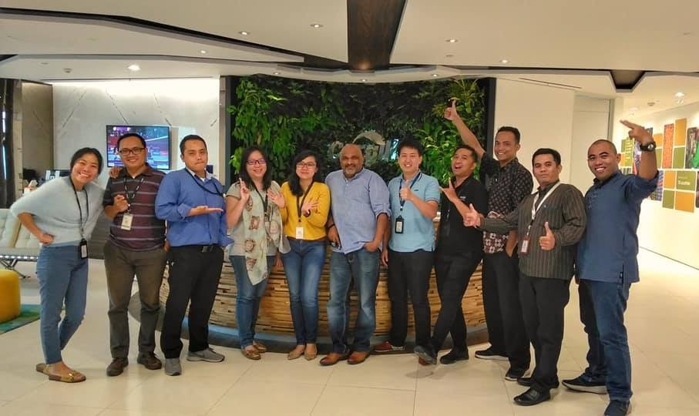
ADI
SETIADI
With my passion for data and my drive to deliver impactful solutions, I am confident in my ability to drive business success through insightful reporting
2 Yrs
Digital Marketing & Business Analytic Consultan
7.9 Yrs
Production Excellence & Manufacturing Technology Coordinator
5 Mnth
Head of Administration Management Trainee
200+
Project
03/

Slide 4
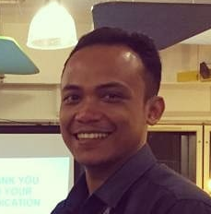
About me
ADI MULYA SETIADI
ASSOCIATE PROFESIONAL | PRODUCTION EXCELLENCE | BUSINESS ANALYST
Throughout my tenure at Cargill, I have demonstrated a commitment to results, leveraging my skills in financial performance monitoring and forecasting to identify areas for improvement and maximize profitability. I have built strong relationships with key stakeholders, both internally and externally, to ensure effective communication and collaboration.
In addition to my experience at Cargill, I am a certified Microsoft Business Analyst, Project Management and a Certified Lean & Six Sigma. I strive to stay up-to-date on the latest best practices and trends in business analysis, and I am a highly motivated self-starter who enjoys working in dynamic and challenging environments.
04/ ¹³

Slide 5
EDUCATION BACKGROUND
2006
2014
Management Trainee
2023
Indonesia Open University
High school
PGRI 3 CIMAHI Technical High School
Poliplant - Cargill Learning Centre
Universitas Terbuka
Electro Industry
Head of Administration Management Trainee
Bachelor of Information System Undergraduated

Slide 6

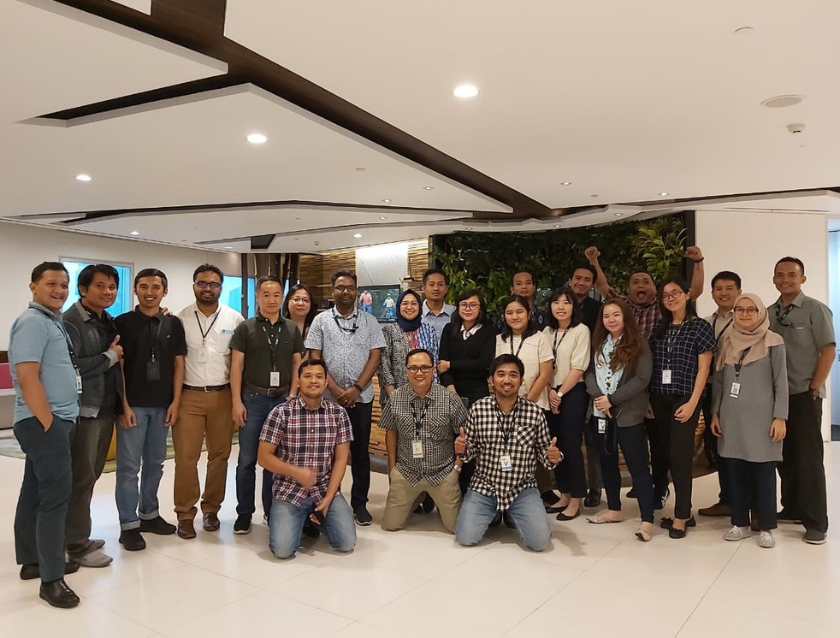


WORK
EXPERIENCE
1.5 yrs | PT. Tridayamas Sinarpusaka
| Purchasing Assistant |
1 yrs | Training Centre Supervisor
5 Mnths | Management Trainee
6.7 yrs | Production Excellence & Manufacturing Technology Coordinator

Slide 7
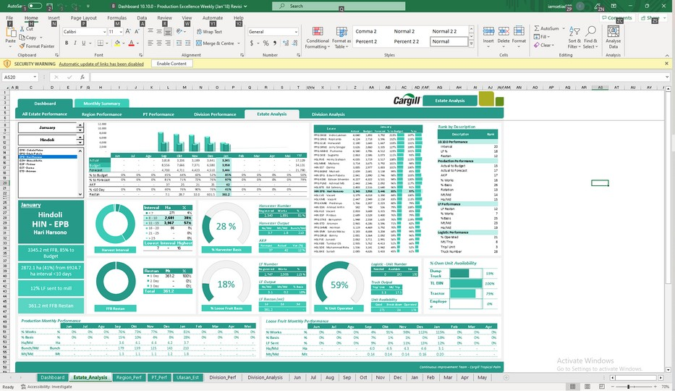
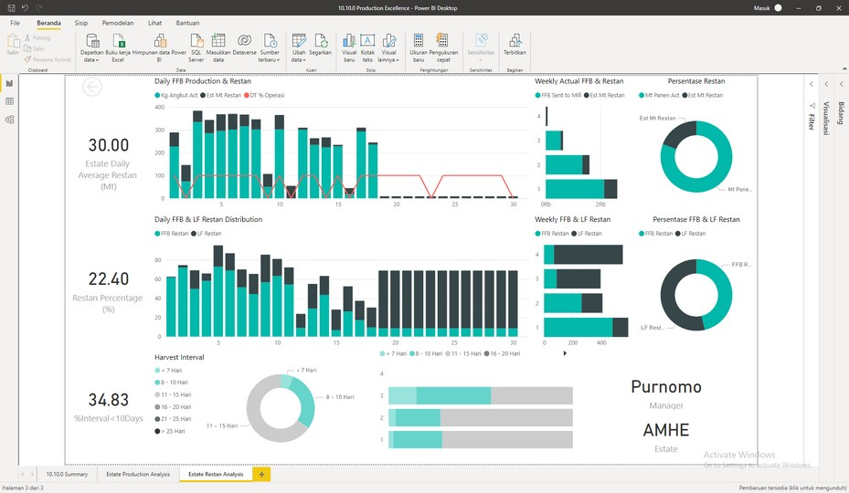
Personal
Skills
EXCEL DASHBOARD
INSIGHT (BI)
STORYTELLING DATA (PRESENTATION) PRODUCTION EXCELLENCE
PROJECT MANAGEMENT
CONTINUOUS IMPROVEMENT BUSINESS TRANSFORMATION CONTINUOUS IMPROVEMENT
POWER BI & TABLEAU

Slide 8
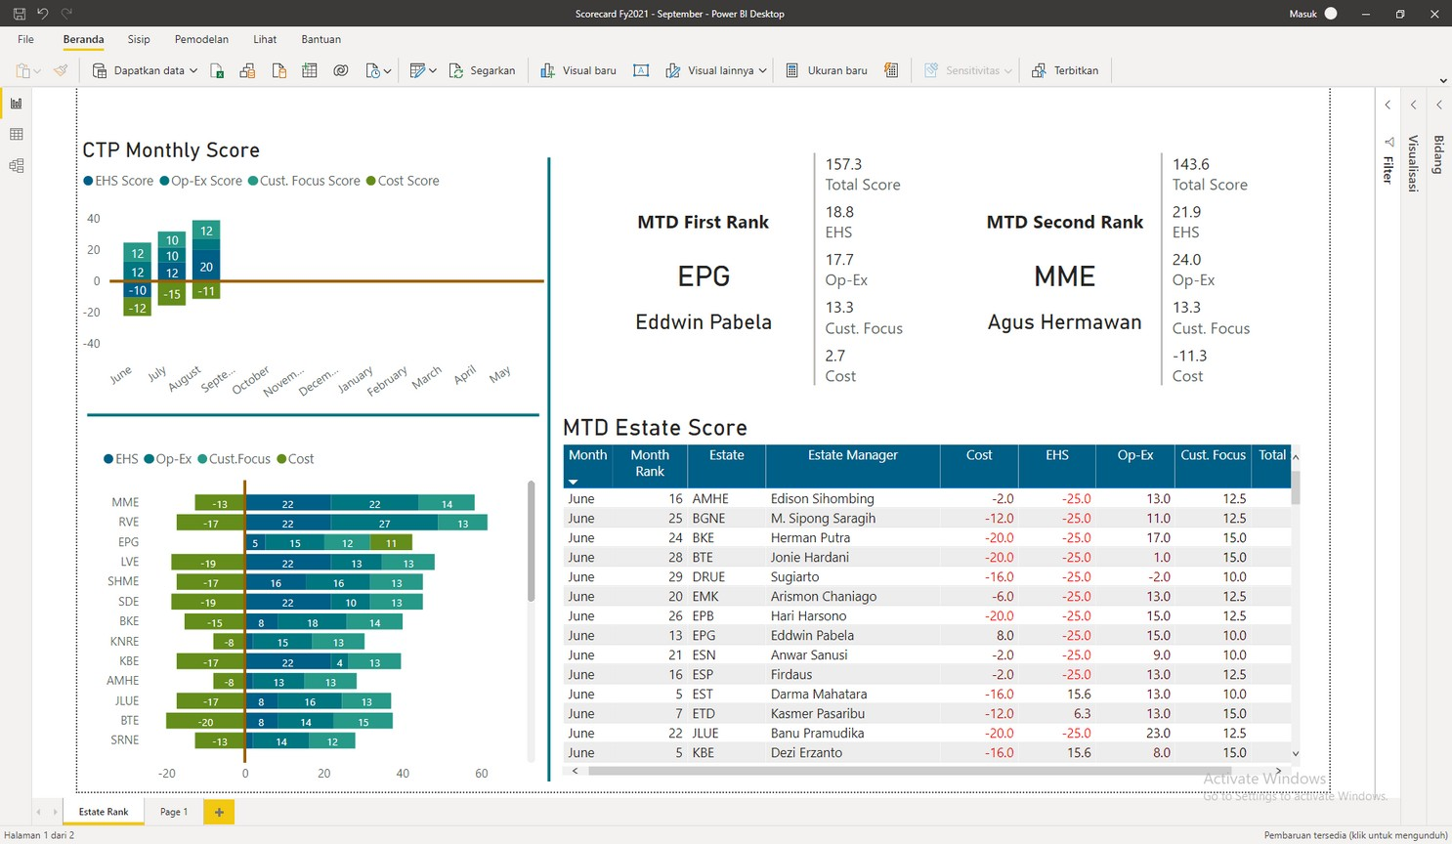

CTP Balance Scorecard - Production Excellence
Create Dashboard & Handling 30 Estate Manager ranking using balance scorecard to decide mtd to ytd Manager Ranking
PORTFOLIO
08/
13

Slide 9
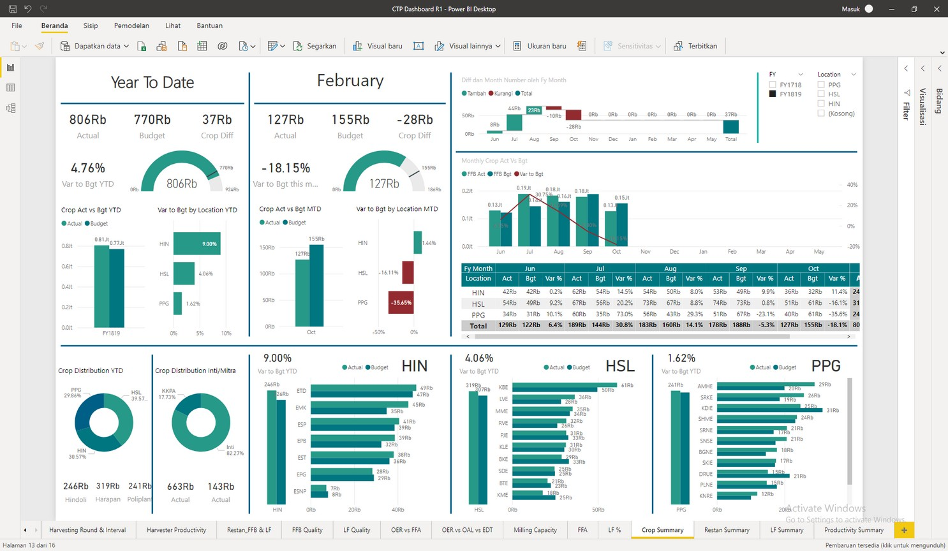

Cargill Tropical Oil
Production Management Dashboard
Describing group production report mtd to ytd
PORTFOLIO
09/
11/ ¹³
13

Slide 10
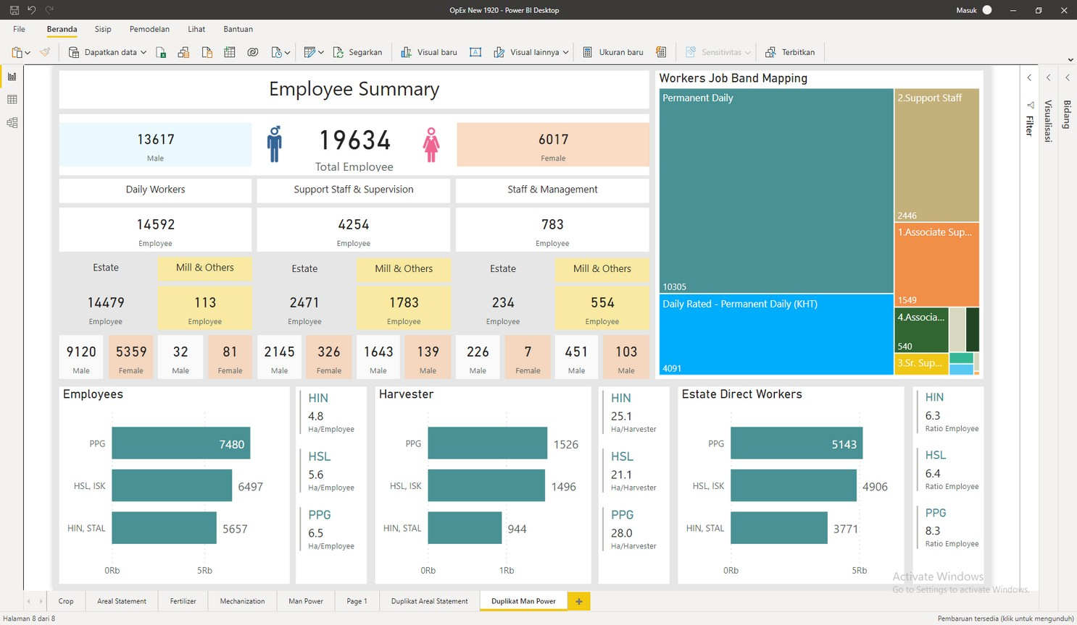
PORTFOLIO
Cargill Tropical Oils
HR Employee Mapping
Mapping ~19.000 Labor at Cargill Tropical Oil
10/

Slide 11
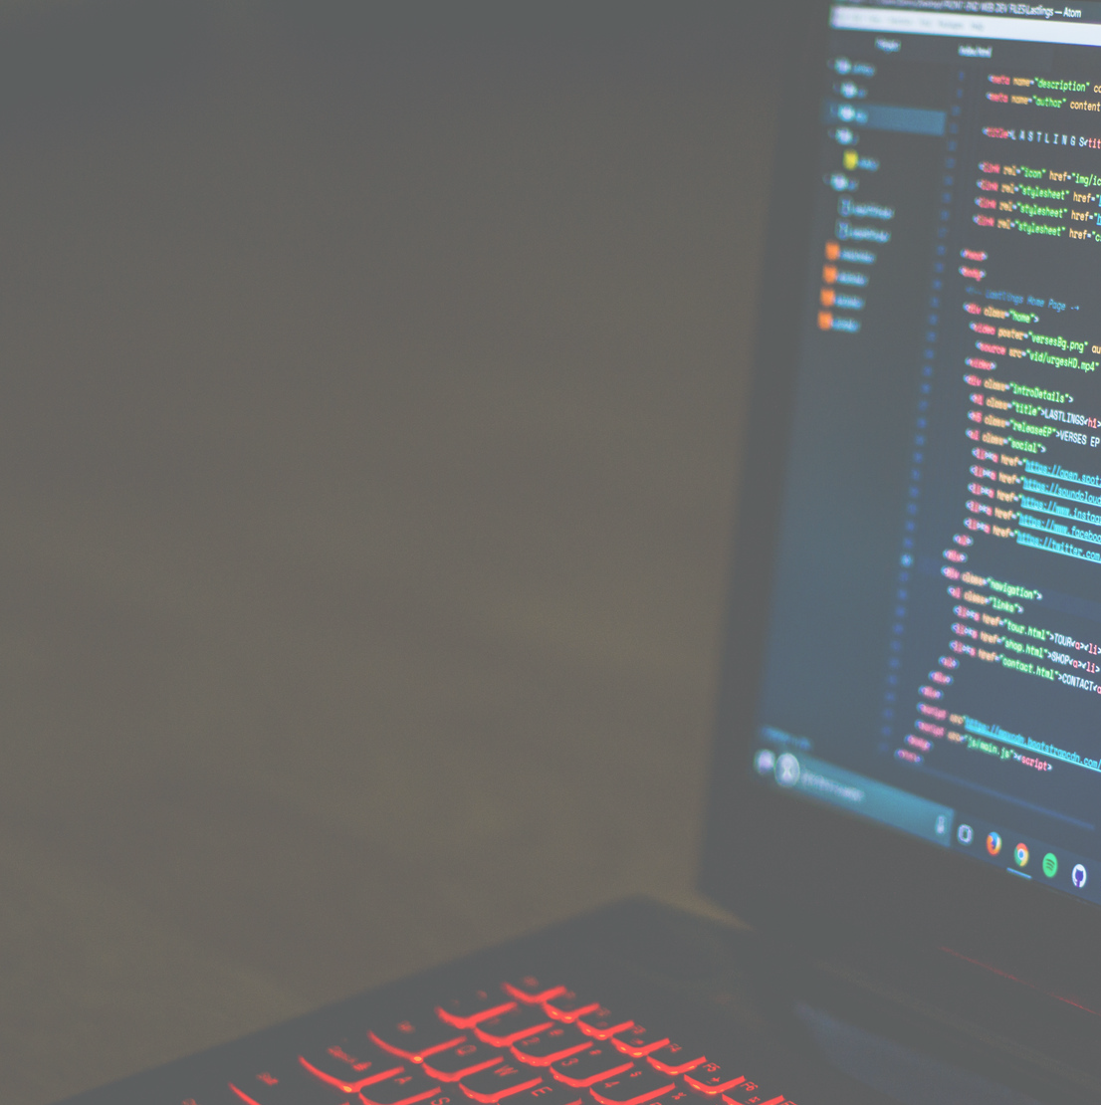
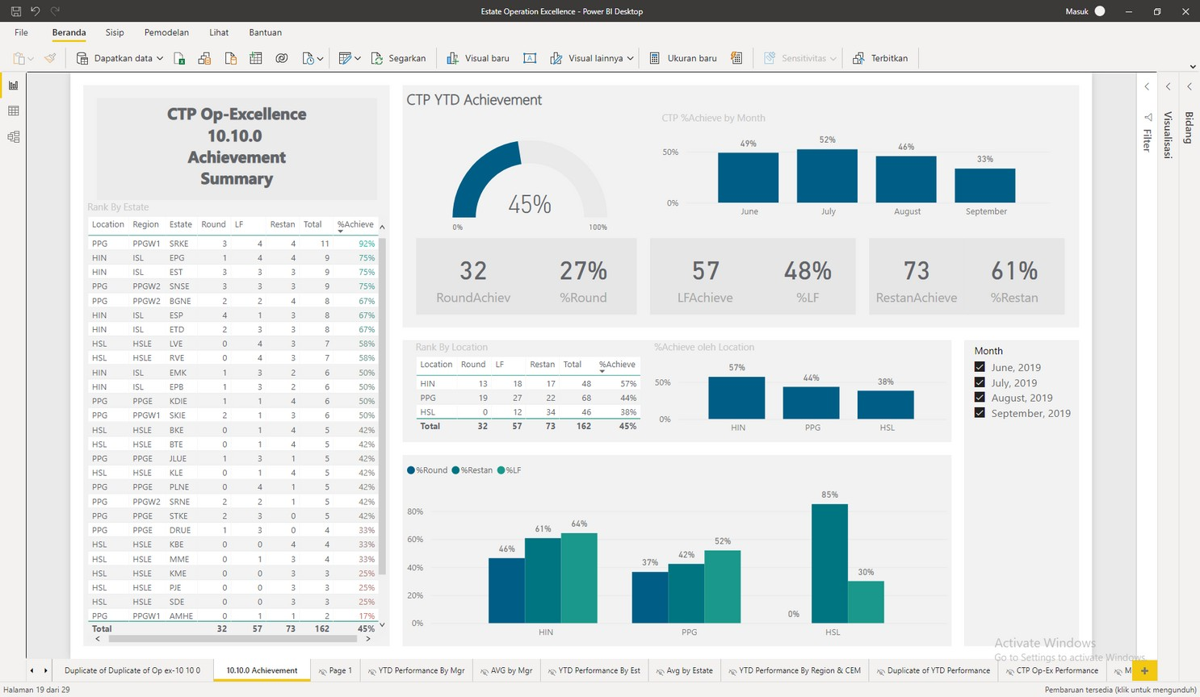
PORTFOLIO
CTP Operation Excellence - Production Excellence
Handling 30 Estate Manager ranking using Op-Excellence to decide mtd to ytd Manager Ranking
11/

Slide 12
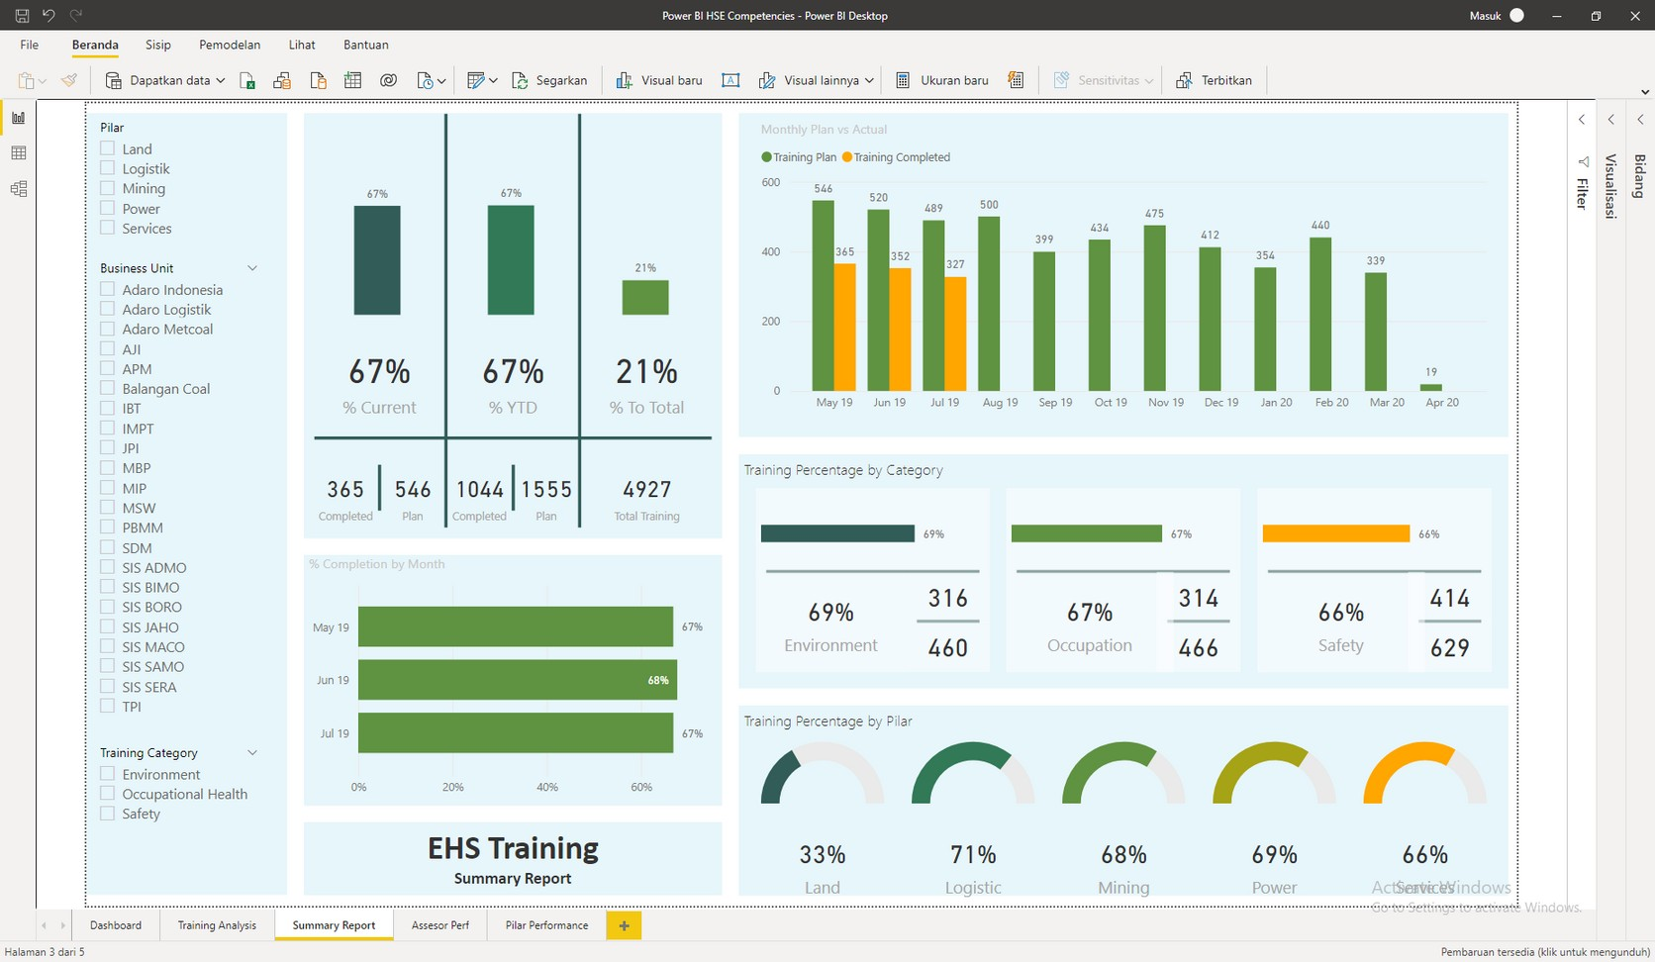
PORTFOLIO
Adaro EHS Training
EHS Training Dashboard from 5 pilar of Adaro Group to Compare and monitor Training Plan vs Actual Training Completed
12/

Slide 13
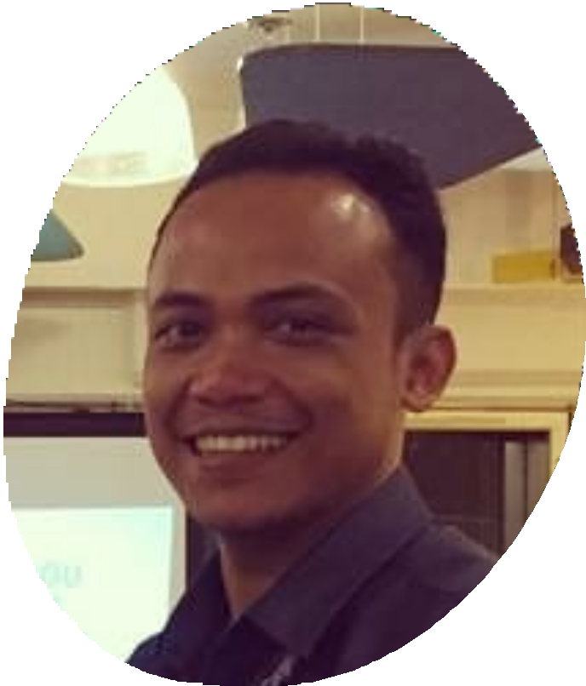
LET'S WORK
TOGETHER
MY CONTACT
+62 822 8240 8825
iamsetiadi88@gmail.com https://www.linkedin.com/in/adi-setiadi/

